Slide 1




Addressing the Pandemic of Science Misinformation on the Internet
Presented by Alexia Grant and Sarah Stamer
Mentors: Dr. Chris Impey & Dr. Matthew Wenger, Steward Observatory
2022 Arizona NASA Space Grant Symposium
Tucson, AZ, April 23, 2022

Slide 2
Most of the public supports science.
YET
Only a small percentage of U.S. adults are scientifically literate.
Notes:
SARAH
Most of the public believes that science is beneficial and makes life easier, but a large fraction of the public questions issues where the research community is in nearly unanimous agreement. Only 15% of U.S. adults are scientifically literate - defined as correctly answering ⅔ of a series of simple questions about science and expressing what it means to study something scientifically in a National Science Foundation survey. The Internet in recent years became the primary source of science information, Googling a topic or looking at it on social media instead of researching has become popular with younger adults, and older adults tend to share misinformation on social media.
[Public: science has been more beneficial than harmful, that it has made life easier, and that it has created more opportunities for the next generation
The same NSF surveys, the biannual “Science and Engineering Indicators” series, report that only 15% of U.S. adults are scientifically literate - defined as correctly answering ⅔ of a series of simple questions about science and expressing what it means to study something scientifically.
A large fraction of the public questions issues where the research community is in nearly unanimous agreement (Hornsey et al. 2016, PRC 2014). Especially among younger Americans, the Internet is the primary source of information on any scientific issue, eclipsing magazines, newspapers, and books (PRC 2006).
Although the public does trust science-specific news sources, they more frequently get their science information from general news outlets (PRC 2017) and on social media (PRC 2018). The next generation of adults uses search engines uncritically, such that “Googling” a topic is considered to be the same as researching it (PRC 2012). It is older adults, however, that are the most likely to share misinformation on social media (Guess et. al. 2019). Meanwhile, major search engines use proprietary algorithms that benefit web sites according to the amount of original content, traffic, and number of links from other sites (Google 2017). The authenticity of the information or the science credentials of the author do not drive the search ranking, and first page results generate 90% of Google web traffic (Chitika 2013).]

Slide 3
The Pros and Cons of Online Publications
PROS
CONS
Easier public access to science information
Media releases spread information quickly
Publications can come from other places other than traditional journals
Easier for the public to access false science information
Scientific results can be sensationalized
Publications beyond traditional journals might lack peer reviews
Notes:
Funny titles without the facts
Early media releases
Publication Bias

Slide 4
Project Objectives
Develop and test Artificial Intelligence system (AI) to detect science misinformation
Utilize AI on both online non-technical articles and student science writing
Notes:
SARAH
The goal of this project is to develop and test a novel artificial intelligence system designed to detect science misinformation online. Neural networks will be trained with curated sets of non-technical scientific articles, comprised of equal numbers of legitimate and misleading or “fake” articles. Initial testbeds will be on climate change and evolution, culminating in a wide range of science topics. After the training phase, the machine learning will be applied to large samples drawn from the CommonCrawl of the entire world wide web. This data will be used to diagnose the prevalence of science misinformation online.

Slide 5
Prior Work & Research Setup
Article Selection Process
100 articles per 10 pseudoscience topics
Similar numbers from pseudoscience websites and from websites with legitimate science content
Notes:
SARAH
The data is articles from the web, aiming for similar types of writing for each – so blogs and popular articles rather than technical or research articles.
The goal is about 1000 fake and 1000 real articles.
500-1000 words is ideal
· For real science, stick to reputable scientist bloggers, authors, journalists.
Can use quality mass media for real science (Economist, BBC, Guardian).
· In some pseudoscience areas, it will be hard to find good science content.
· For fake science, avoid frivolous, trivial sites, or deep conspiracy theorists.
· Try not to let any single content source dominate any particular category.
Astrology, Biology, Climate, Evolution, Geology, Paranormal, Physics, Spiritual, Superstition, UFO

Slide 6
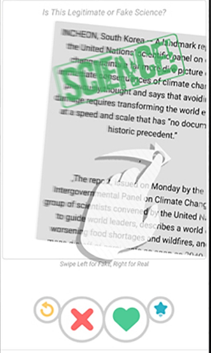
Stage 1: Science Tinder
260 article classification set
10 different pseudoscience topics
Interface similar to Tinder; swipe left or right to classify
Notes:
Alexia

Slide 7
Stage 2: Claim-Evidence Picker
Notes:
Alexia

Slide 8
CER Model of Writing
CLAIM: “What is the author’s argument?”
EVIDENCE: “What factual information does the author provide?”
REASONING: “How does the evidence given support the author’s claim?”
Notes:
Alexia

Slide 9
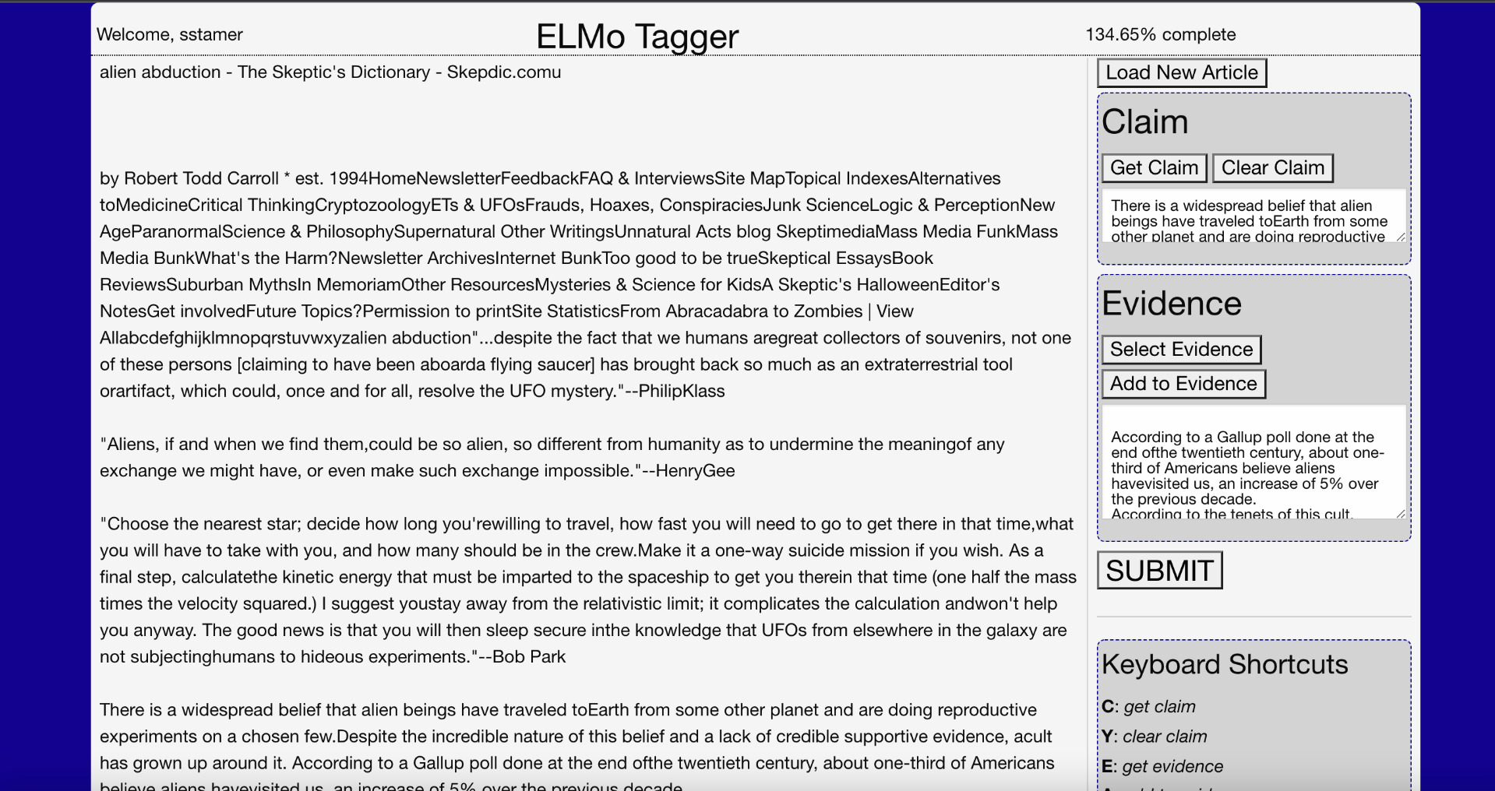
Notes:
Alexia

Slide 10
Stage 3: Student Writing
From a general education astronomy course
Three assignments: Mars missions, Fermi’s Paradox and Drake Equation, Chernobyl versus pandemic
456 total assignments, about 150 per assignment
Notes:
SARAH

Slide 11
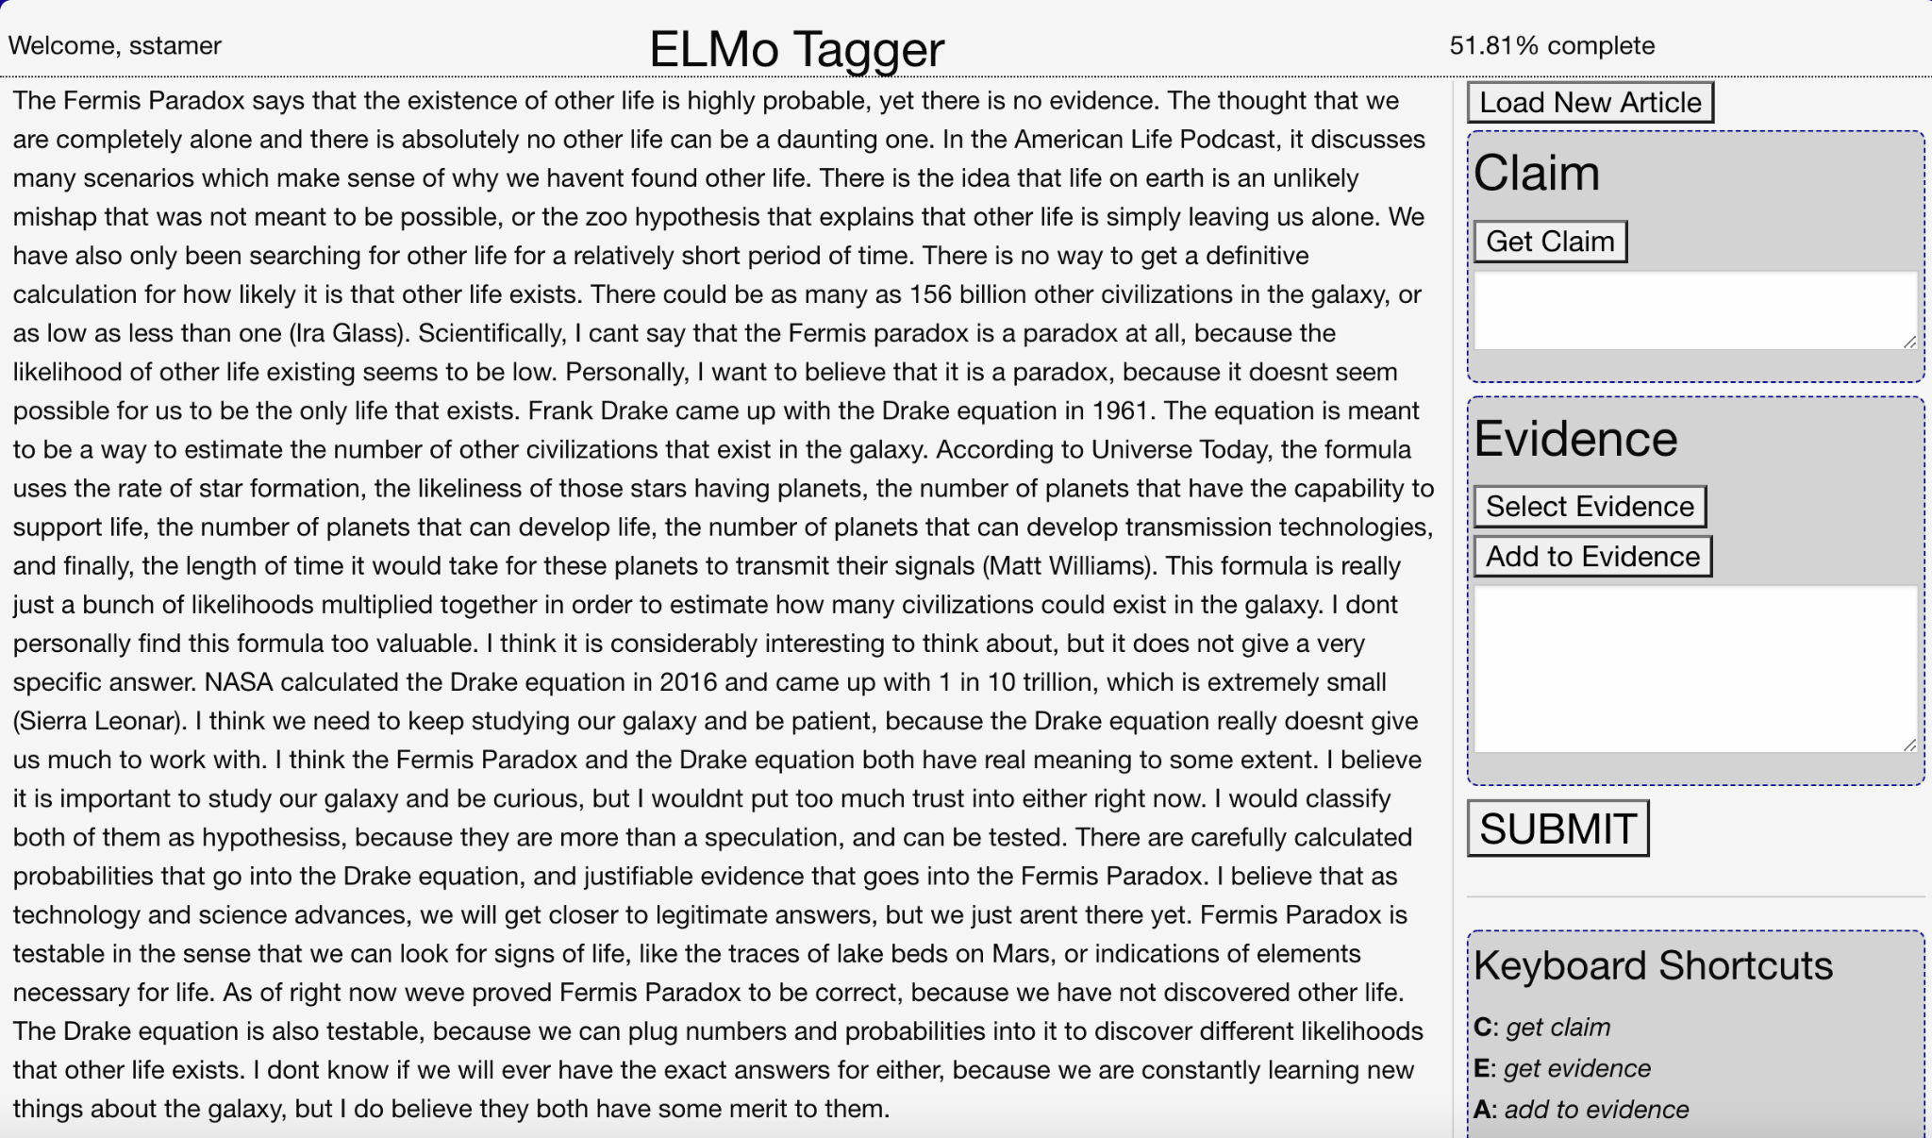
Claim-Evidence Picker No. 2
Notes:
SARAH

Slide 12
Results
While our project is still in development…
AI can successfully distinguish fake/real science most of the time
Students who follow the claim-evidence-reasoning framework in writing score higher

Slide 13
Interpretations: strong data set to use with testing AI, understanding how claim-evidence-reasoning framework contributes to good science writing
Future Use/Directions: browser extension, app, science general education professors

Slide 14
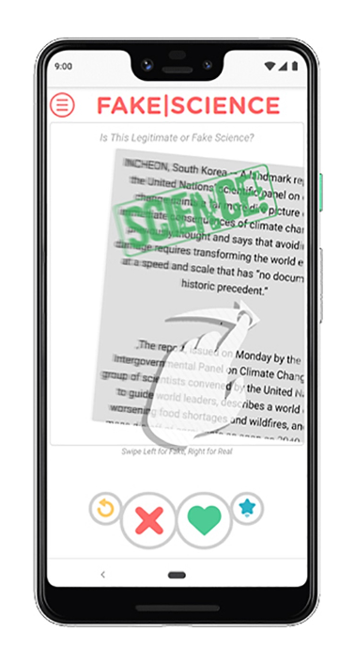
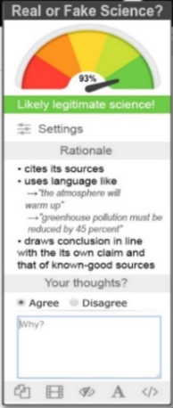
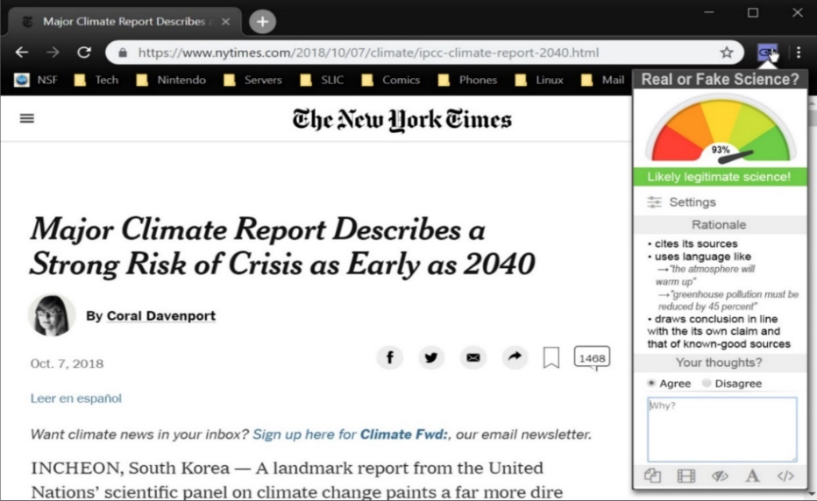
Future Directions
Notes:
SARAH

Slide 15
Thank you to
Dr. Chris Impey, Dr. Matthew Wenger & Alexander Danehy
We would also like to thank the
Arizona/NASA Space Grant Consortium
This material is based upon work supported in part by the National Science Foundation under Grant 3037130. The material contained in this document is based upon work supported by a National Aeronautics and Space Administration (NASA) grant or cooperative agreement. Any opinions, findings, conclusions or recommendations expressed in this material are those of the author and do not necessarily reflect the views of NASA. This work was supported through a NASA grant awarded to the Arizona/NASA Space Grant Consortium.

Slide 16
Thank you!

